Slide 1
Deep Learning for Precipitation Nowcasting: A Benchmark and A New Model
Xingjian Shi, Zhihan Gao, Leonard Lausen, Hao Wang, Dit-Yan Yeung,Wai-kin Wong, Wang-chun Woo
The paper presents a new approach for predicting short-term rainfall using deep learning techniques. The authors highlight the limitations of traditional methods and previous deep learning models, proposing the Trajectory Gated Recurrent Unit (TrajGRU) model to address these issues. The key contributions include:
1. TrajGRU Model
2. Benchmark Dataset(HKO-7)
3. Evaluation and Comparison: Extensive experiments showing that TrajGRU outperforms existing models, including ConvLSTM, ConvGRU, and optical flow-based methods.

Slide 2
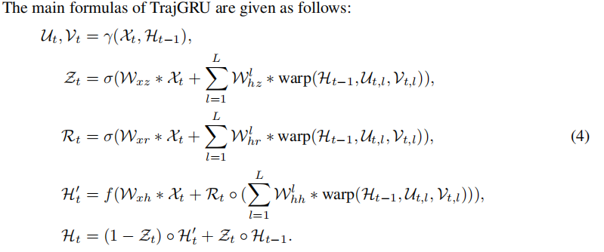
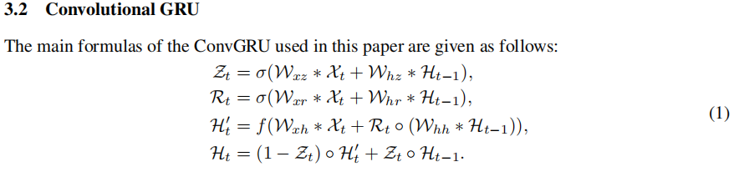
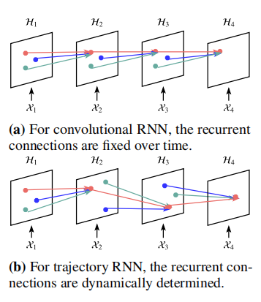
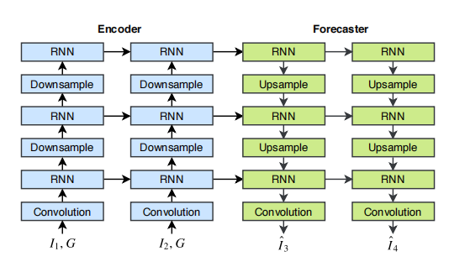
Model and Algorithm
Comparison of the connection structures of convolutional RNN and trajectory RNN.
Encoding-forcasting structure used in this paper

Slide 3


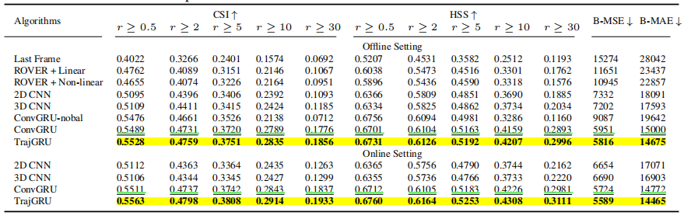
Evaluation Methodology
offine setting: the algorithm reveives 5 frames as input and predicts 20 frames ahead.
Online Setting: The algorithm receives segments of length 5 sequentially and predicts 20 frames ahead for each new segment.
*thresholds: 0.5,2,5,10,30 to calculate
CSI
HSS
Evaluated Algorithm
Optical FLow Methods:
ROVER
Nonlinear ROVER
Deep Learning Methonds
2D, 3DCNN
ConvGRU
TrajGRU
Model Training
online setting: Fine tuning with AdaGrad, Learning rate 10-4. Optimizing sum of B-MSE and B-MAE during training.
Offile Training: Optimized by Adam optimizer, learning rate 10-4, momentum 0.5. Early stopping based on B-MSE and B-MAE.
Batch sizes: RNN-4, CNN-8
Evaluation Results
Optical Flow Models
ConvGRU (without balanced loss) performs worse at higher rainfall thresholds (10mm/h and 30mm/h).
Deep Learning models
TrajGRU: Best Performace
3D CNN: Outperforms 2D CNN
The improvement of TrajGRU over the other models is statistically significant because the differences in
B-MSE and B-MAE are larger than three times their standard deviation. Moreover, the performance
with online fine-tuning enabled is consistently better than that without online fine-tuning, which
verifies the effectiveness of online learning at least for this task.
THe Overall Results

